Slide 1



Class: X Lab: 12
Python
Iterators

Slide 2


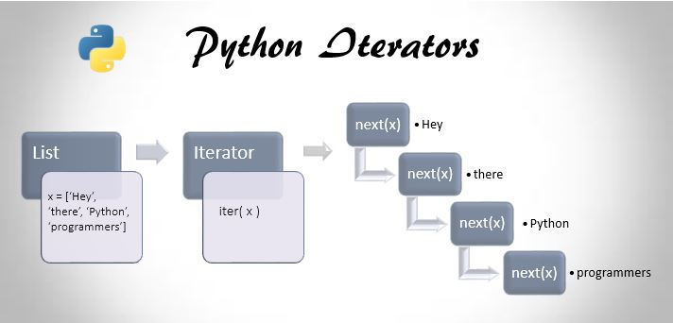
Iterator
Iterator is an object which
allows a programmer to
traverse through all the
elements of a collection,

Slide 3
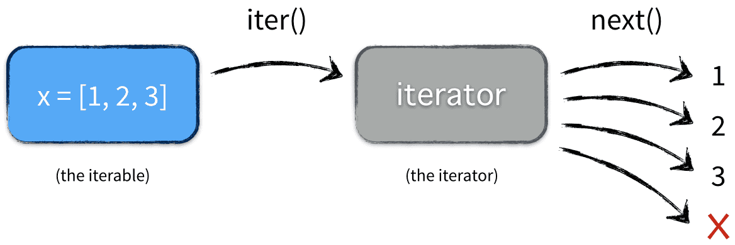
Iterator Example

Slide 4
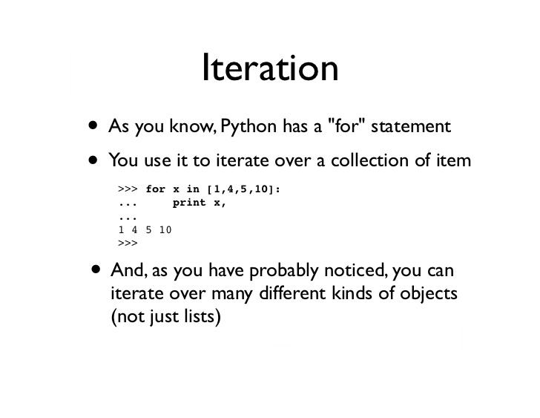
Iteration
Iteration is a general term for
taking each item of something,
one after another.

Slide 5
Create an Iterator
class MyNumbers: def __iter__(self): self.a = 1 return self def __next__(self): x = self.a self.a += 1 return x myclass = MyNumbers() myiter = iter(myclass) print(next(myiter)) print(next(myiter)) print(next(myiter)) print(next(myiter)) print(next(myiter))
To create an object/class
as an iterator you have to
implement the methods
__iter__() and __next__()
to your object

Slide 6
Stop Iterator
class MyNumbers: def __iter__(self): self.a = 1 return self def __next__(self): if self.a <= 20: x = self.a self.a += 1 return x else: raise StopIteration myclass = MyNumbers() myiter = iter(myclass) for x in myiter: print(x)
To prevent the iteration to
go on forever, we can usethe StopIteration statement.
Stop after 20 Iteration

Slide 7
